Slide 1

Central Inspection Framework for Industries in Odisha
July 29. 2017

Slide 2
Background
Government of Odisha developed the Central Inspection Framework for Industries to ensure transparent & hassle-free inspections through resolution No 193734000120153844/I, dated 10.06.2015
Online system replaces manual scheduling of inspections with computerized synchronized inspections for various agencies including
Labour Directorate,
Directorate of Factories & Boilers and
Odisha State Pollution Control Board
Inclusion of inspections under Legal Metrology and Electrical Installations and a one-time joint inspection under Housing and Urban Development are under consideration.
Online portal (http://cicg.investodisha.org) launched on February 14, 2016
4,646 industries covered under this framework
2,958 industries in the State inspected till date through the allocations made by the portal

Slide 3
Objectives of the Framework
Synchronized joint inspection covering Directorate of Factories & Boilers, Labour Directorate and Odisha State Pollution Control Board.
Transparency in the procedure and methodology of inspections
Risk based selection of industries for inspections and automated allocation of inspectors
Same inspector will not inspect the same unit on two consecutive occasions
Prior intimation of inspections and a feedback system for industrial units

Slide 4
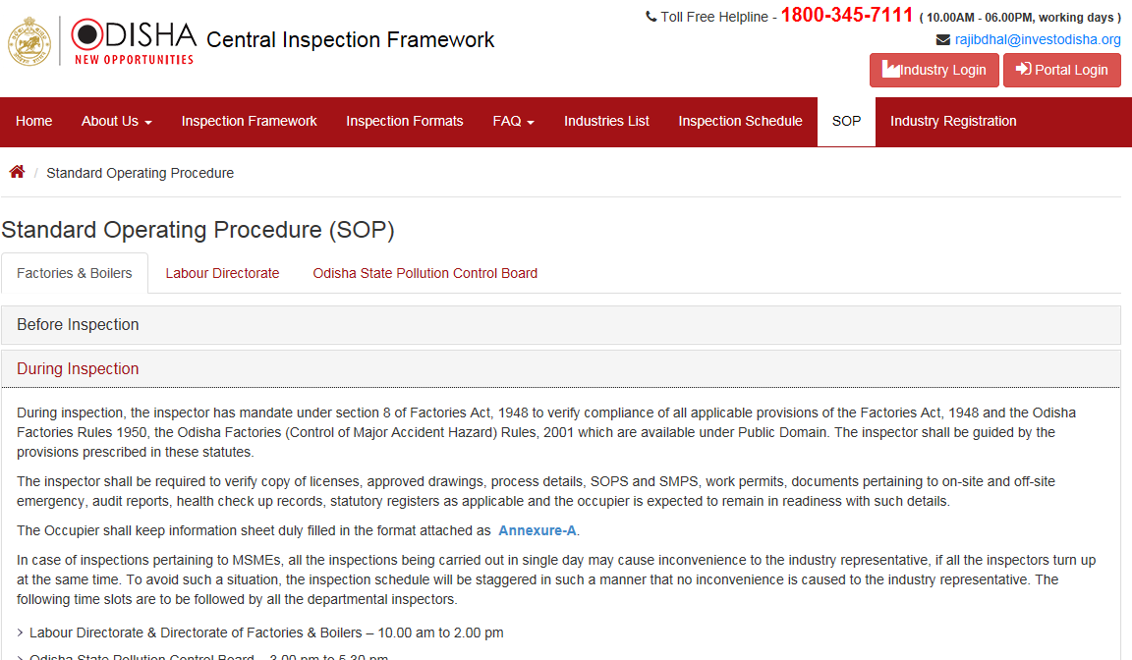
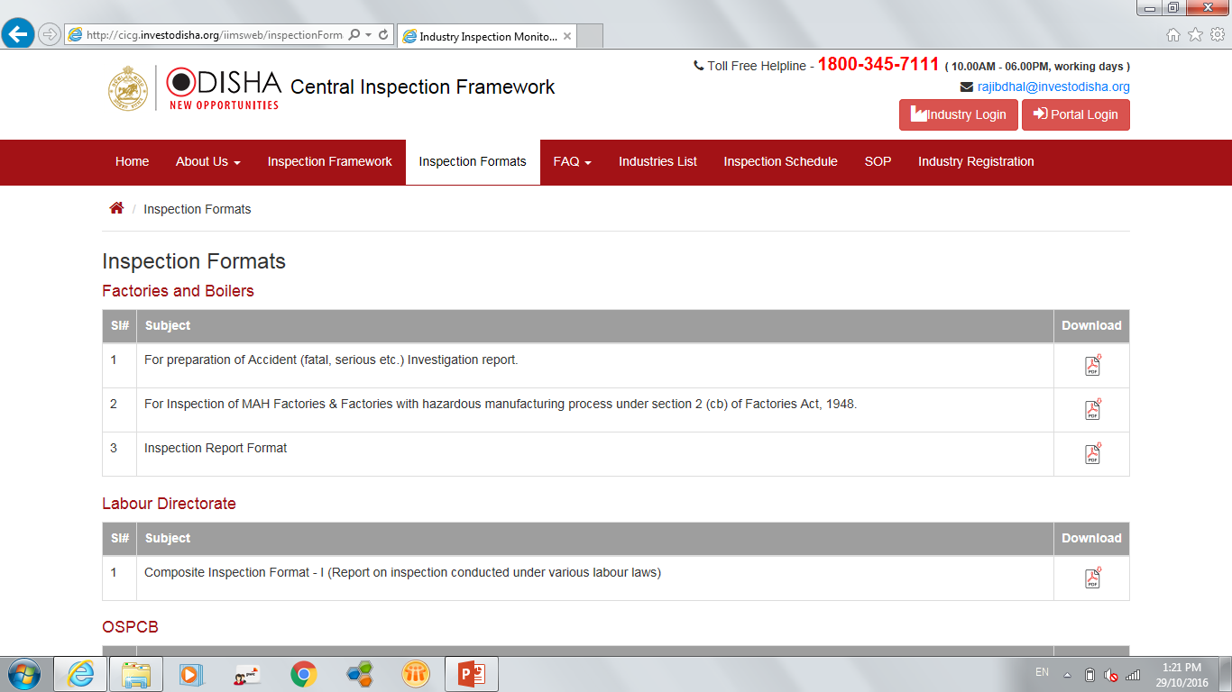
Publicly available Procedures and Checklists for all inspections
Detailed inspection SoP publicly available for the information of industrial units including steps to be followed for the pre, during and post inspection period
Checklists and inspection formats used by the Inspectors made available on the portal
No information sought beyond the checklist

Slide 5
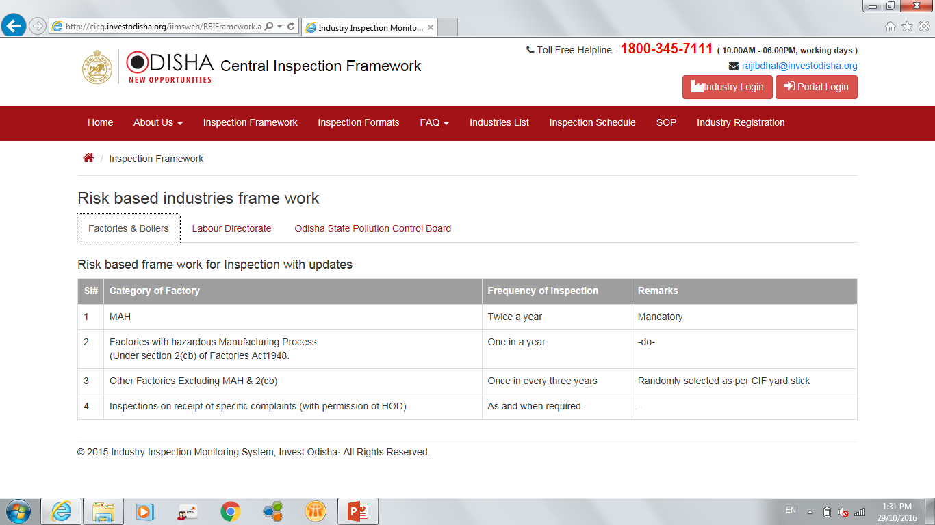
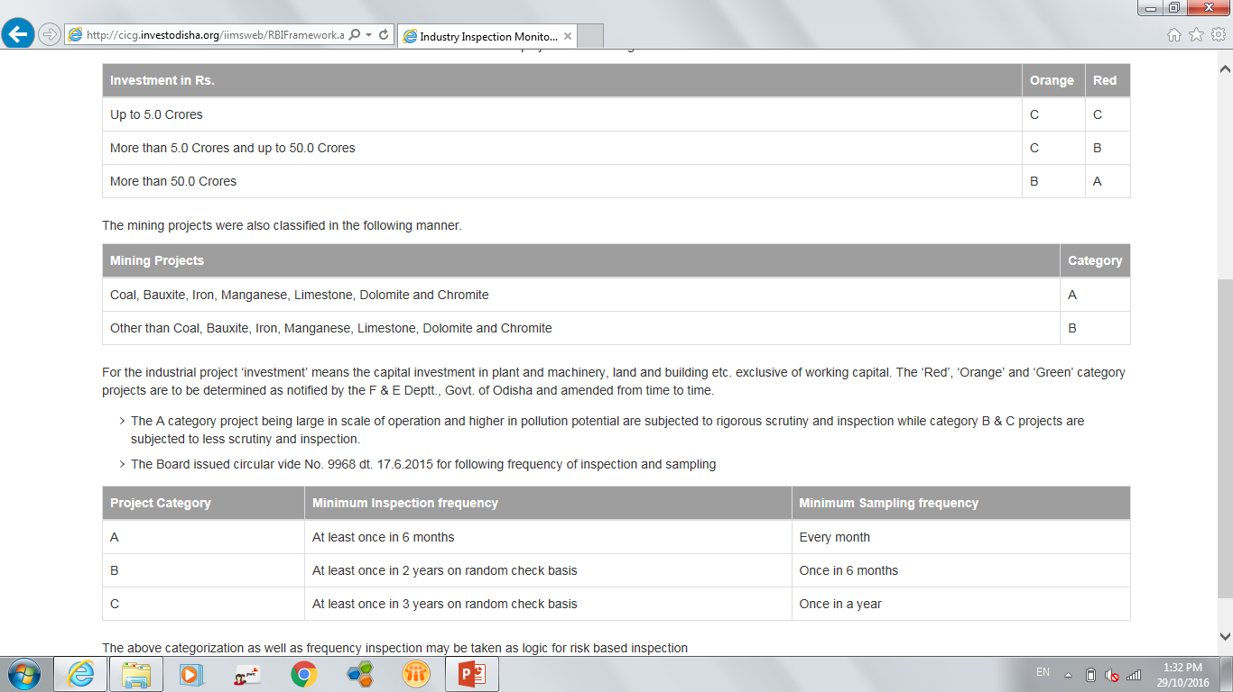
Computerised Risk-based Selection of Industries for Inspection
Risk-based computerised process for selection of industries
All industries assigned a risk rating, based on defined criteria, which are also publicly available on the portal
Based on the defined risk and defined frequency, computerised system schedules a synchronised inspection for all three departments
No human intervention in selection of units for inspection

Slide 6
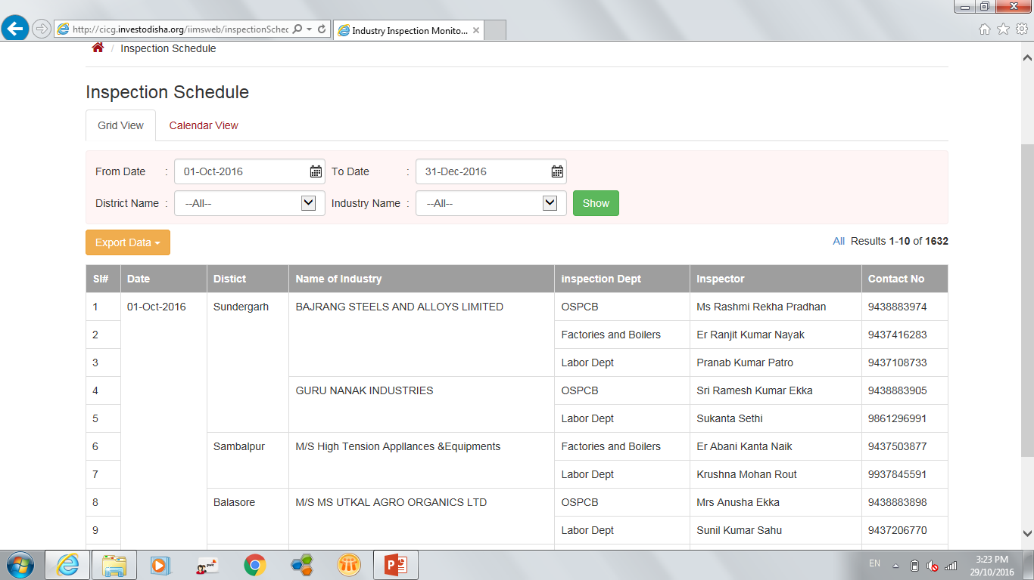
Computerised Random Allocation of Inspectors
To ensure transparency in the inspection process, allocation of inspectors is carried out by the online system in a randomized manner
System ensures that same inspector shall not inspect the same industrial unit in two consecutive inspections

Slide 7
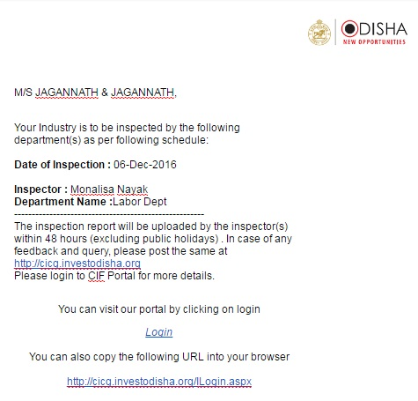
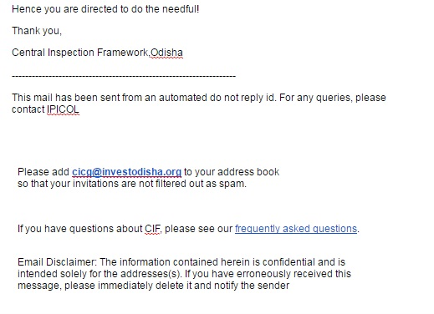
Prior Intimation of Inspections to Units
Schedule for inspections generated three months in advance and made publicly available on the portal
The system sends automated e-mail and SMS updates with inspection details to the units 1 month, 1 week and 1 day in advance

Slide 8
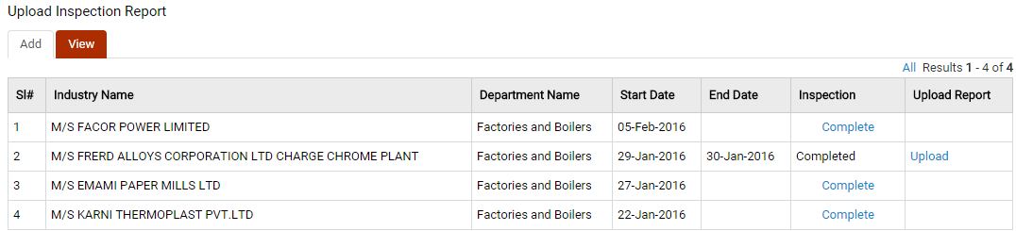
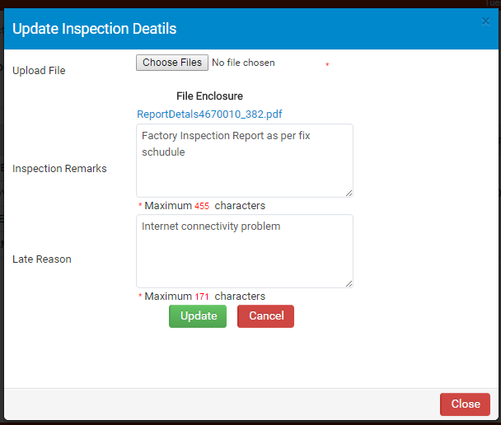
Inspection Report Upload within 48 hours on the Portal
Framework mandates uploading of inspection reports within 48 hours of completion of inspection
Any non-adherance to schedule triggers automated escalation to the Head of the Department and is reviewed every week
Uploaded inspection reports are available for the inspected unit to view after login

Slide 9
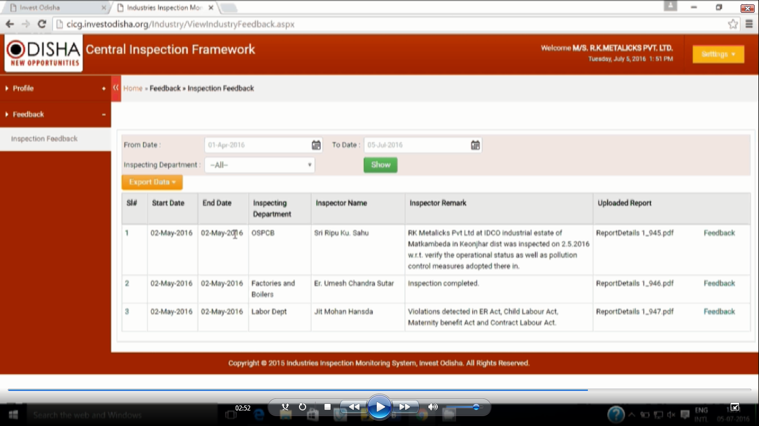
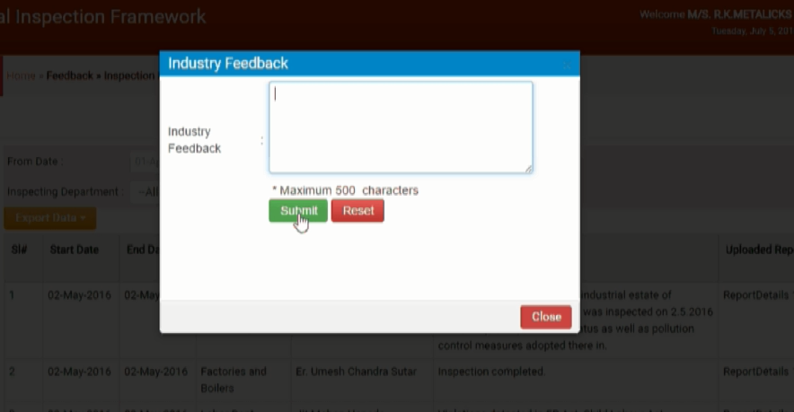
Industry feedback on the Inspection Report/ Inspection
Industrial units have a provision to provide feedback related to the inspection, the inspectors or the inspection report through the same portal
Reported directly to the Head of the Department

Slide 10
Achievements
4.3
Overall CIF Satisfaction Score* (out of 5)
Best Practice- Recognised as a best practice by DIPP in the Ease of Doing Business Rankings, 2016.
99% of inspections being completed as per schedule
90% of inspections being conducted in synchronized manner
Improved transparency and accountability of the inspection process
Industry feedback*
% Satisfaction
* Approx.~ 70 respondents

